Slide 1
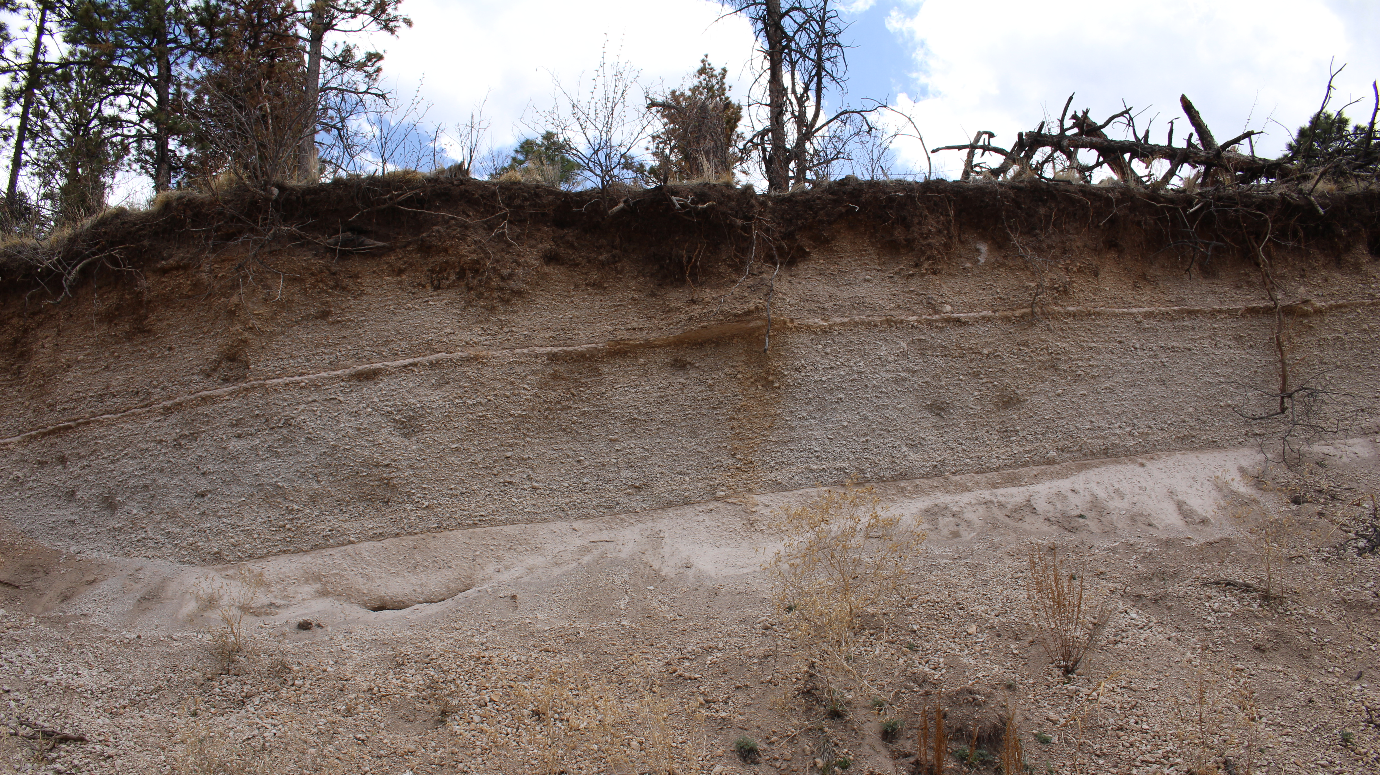

Textural Analysis of Airfall Deposits From the Most Recent Explosive Eruption at the Valles Caldera, NM
Yamini Patel
Mentors: Amanda Clarke, Jacqueline Giblin
Arizona Space Grant Symposium
April 22, 2023

Slide 2
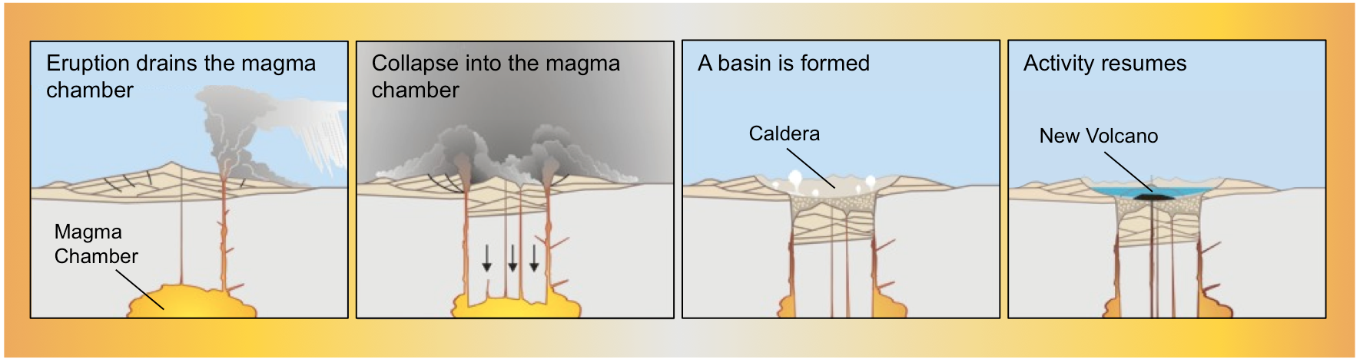
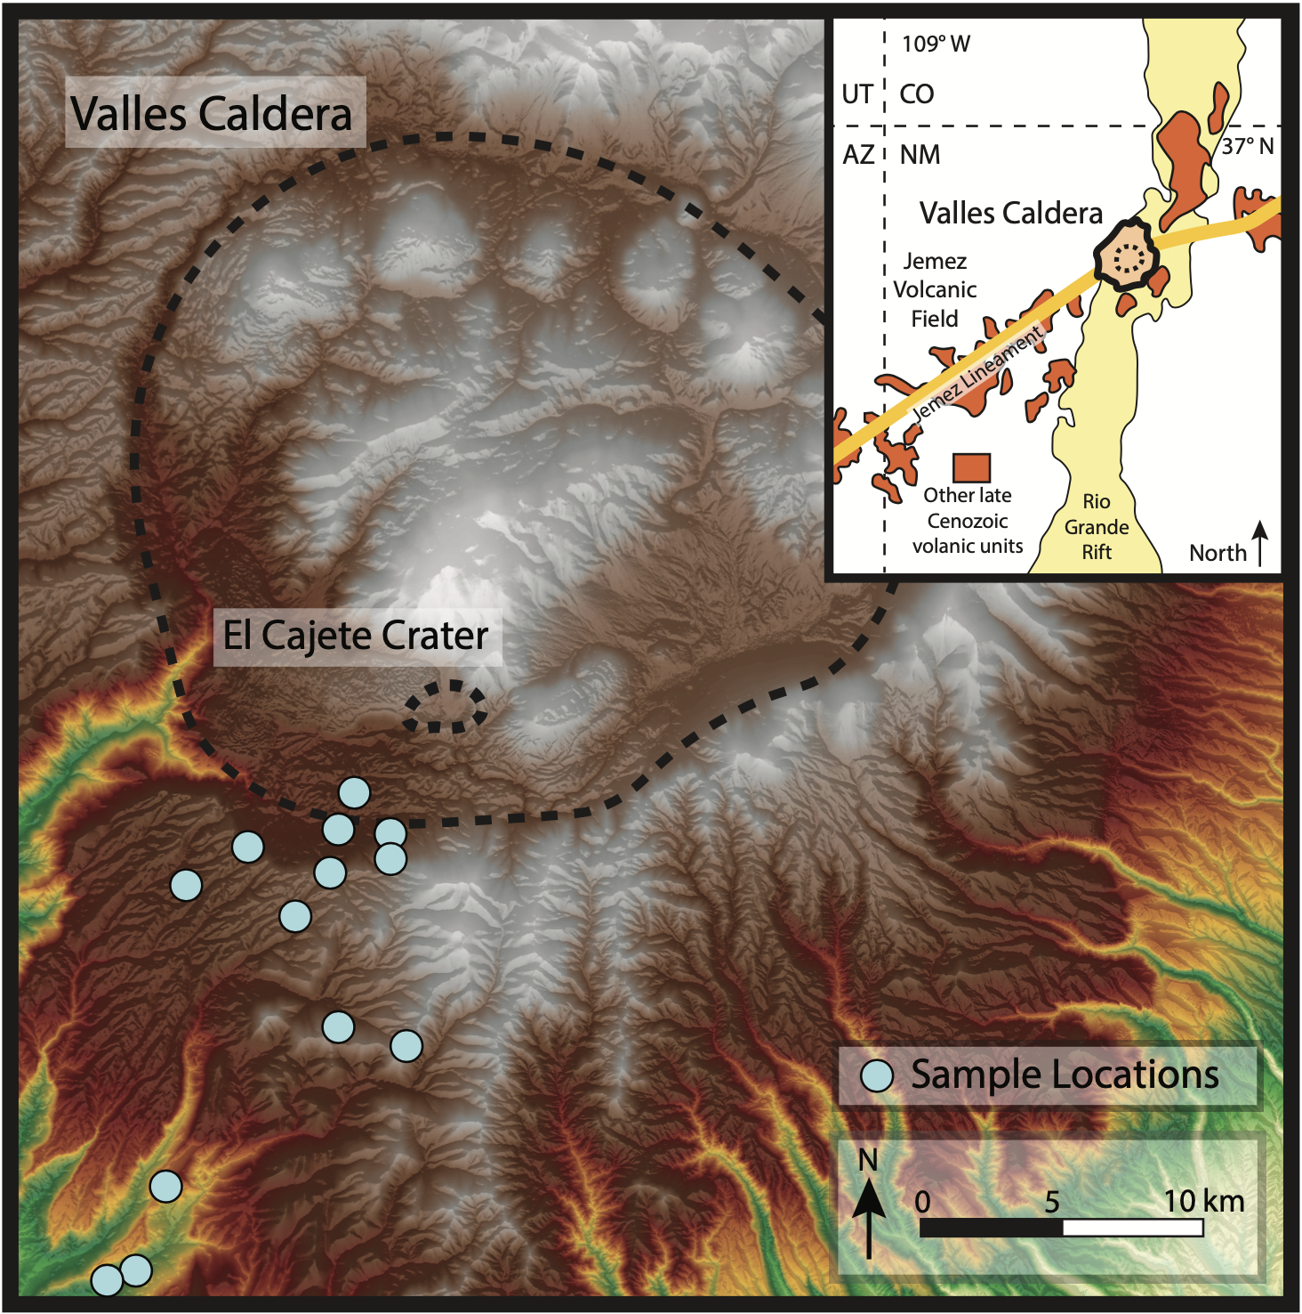
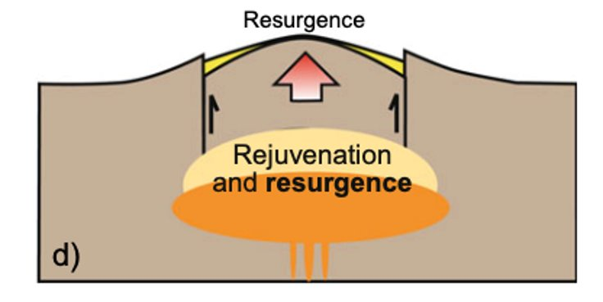
Smaller scale eruptions
Digital elevation model (DEM) of Valles Caldera with sample locations.
‘Restless’ magmatic systems
Formation and rejuvenation of the Valles Caldera, NM. Activity resumes ~50,000 ka, producing the El Cajete pyroclastic deposit.

Slide 3
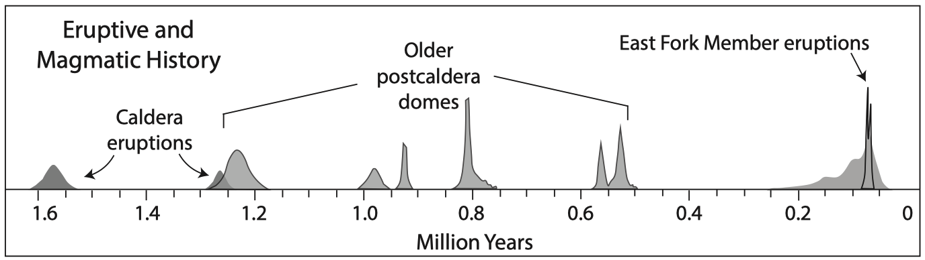
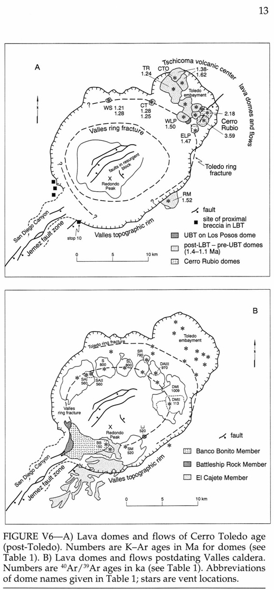

Numerous explosive phases capped by a rhyolitic lava flow.
Modified from Self et al. 1996
Notes:
First 2 major eruption produced a volume of 300-400 km^3.

Slide 4
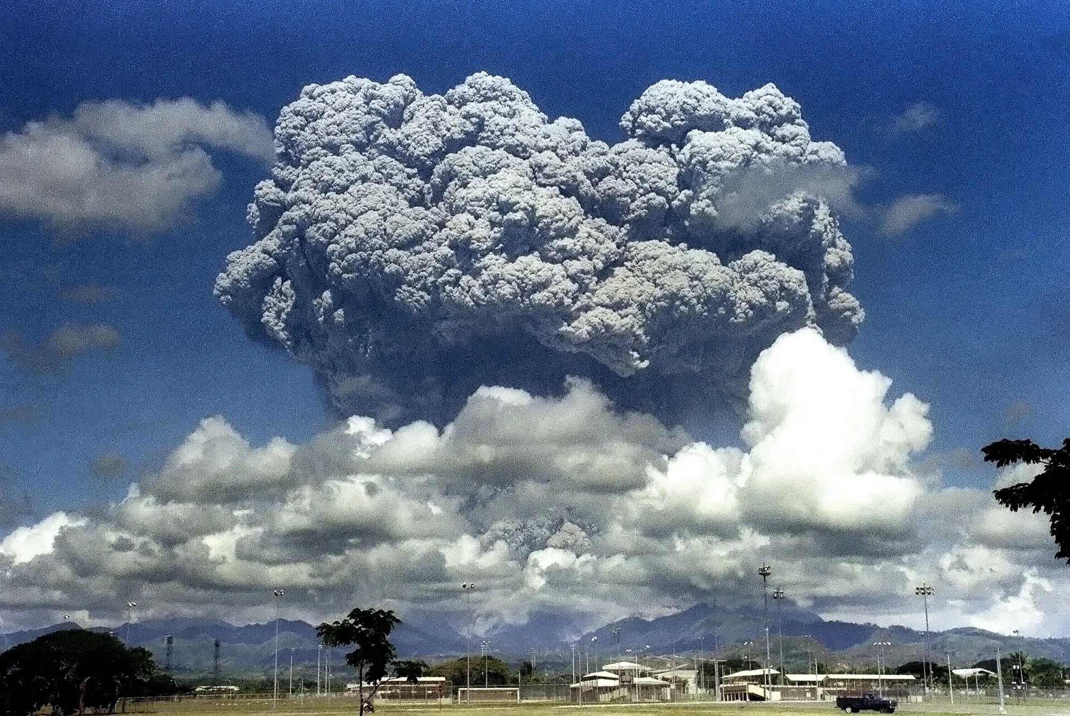
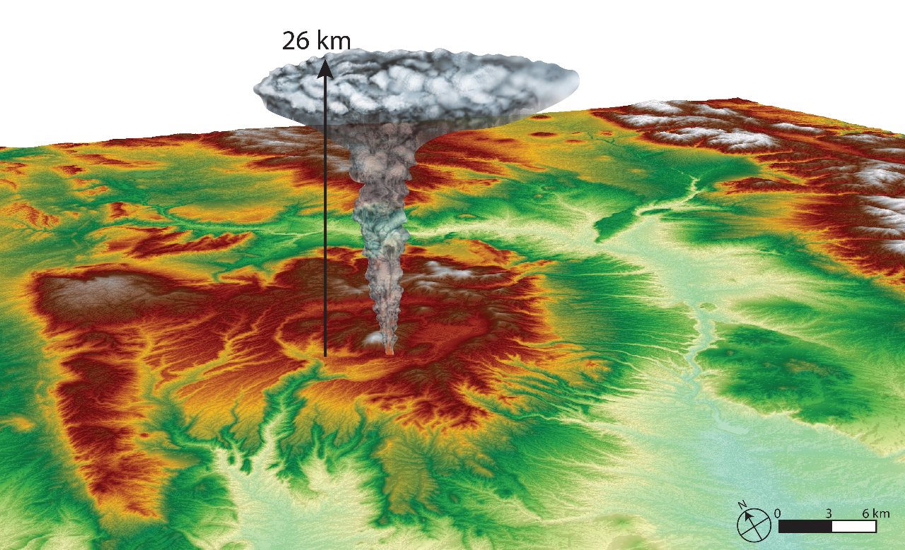
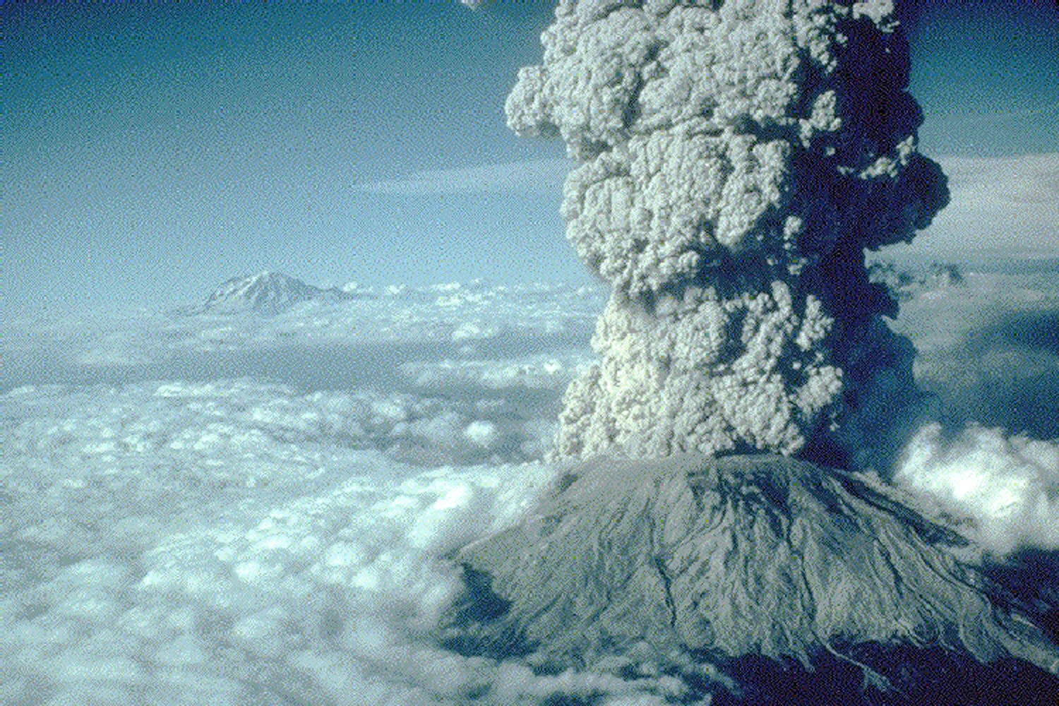
Eruption Characteristics from mapping of JLG
1991 Mt. Pinatubo
~35 km; ~10km³
Column Heights ~ 24 - 26 km
Volume ~ 0.5 - 1 km³
Getty Images
1980 Mt. St. Helens
~20 km; ~1km³
Methods
Bonadonna and Costa, 2012
Carey and Sparks, 1986
Notes:
Isopach maps illustrate the deposit thickness and volume was estimated by integrating isopach contours based on area. Isopleth contour maps reveal the distribution of maximum pumice and lithic clast sizes deposited from El Cajete crater, from which the column height was estimated by using a relationship of the distance clasts are transported from the source to the height of the volcanic plume. Preliminary estimates of the lower unit, reveal a column height of about 26 km and volume of about 1.4 cubic km.

Slide 5
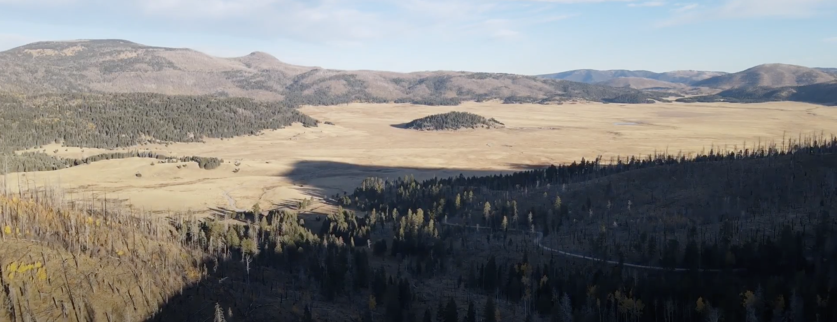
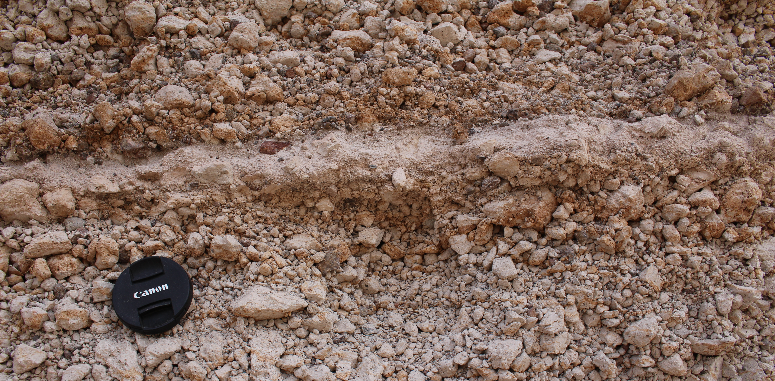

Purpose
Examine the textures of the El Cajete pumice to understand:
  Is there a new batch of magma beneath the caldera?
    Are the pumices petrographically and composition different from the caldera-forming pumice?
    Hypothesized magma mixing.
  Plumbing system dynamics that led to the youngest eruption.
Top image shows an overview of the caldera. Bottom image shows a closeup of the El Cajete Lower and Upper I Units divided by a thin layer of ash (camera lens for scale).

Slide 6
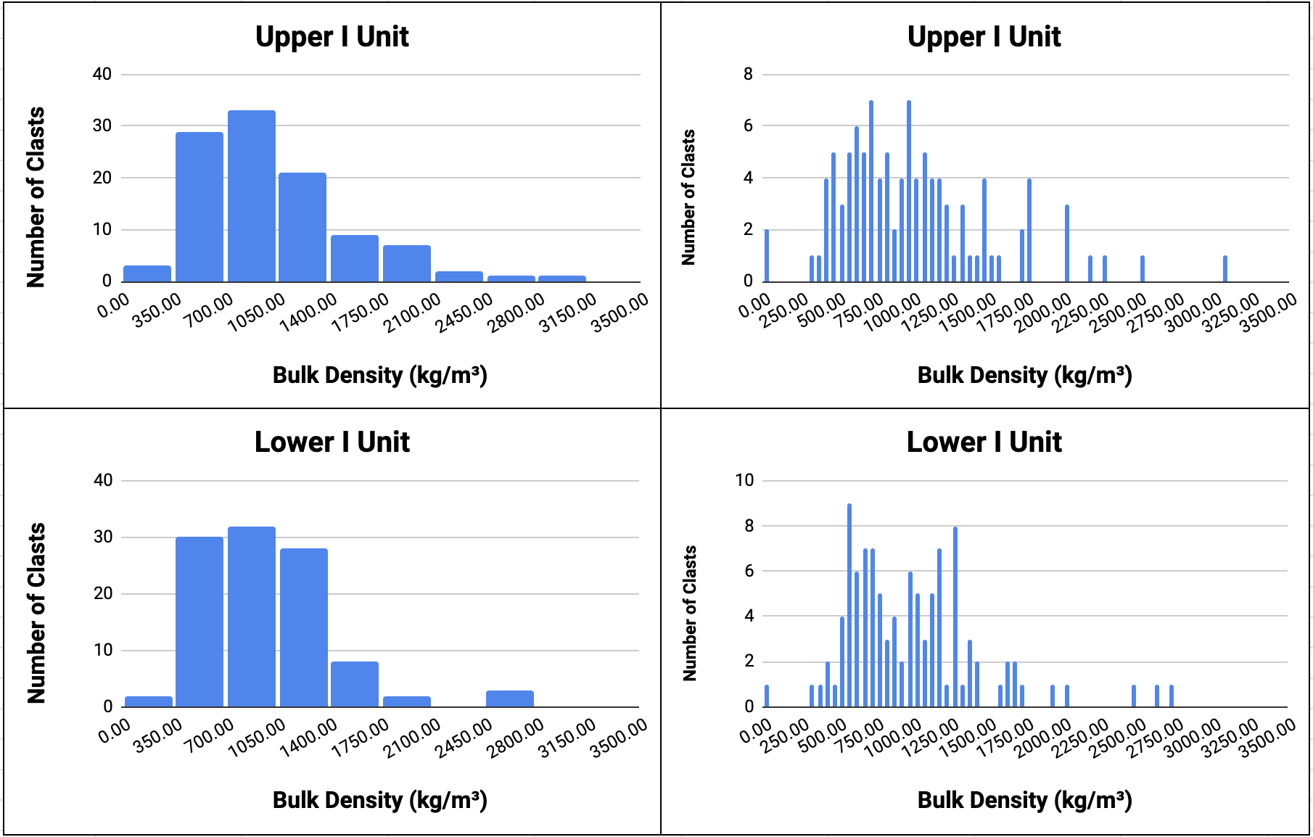
Densities and Methods
Based on the density data, 10 thin sections were selected (outlined in black).
  5 from each unit.
  3 came from the peaks and 2 from the tails ends.
Thin sections were imaged using a petrographic microscope and mapped using Adobe Illustrator.
Mapping involved locating and identifying contacts between different textures, shear textures, and minerals phases present (xenocrysts and phenocrysts) and characteristics.
Histograms suggest 2 peaks indicating a denser outer rim and lighter core of the magma in the conduit during ascent

Slide 7
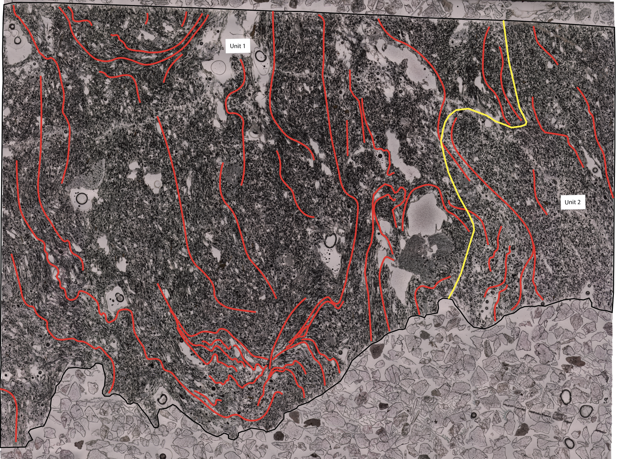
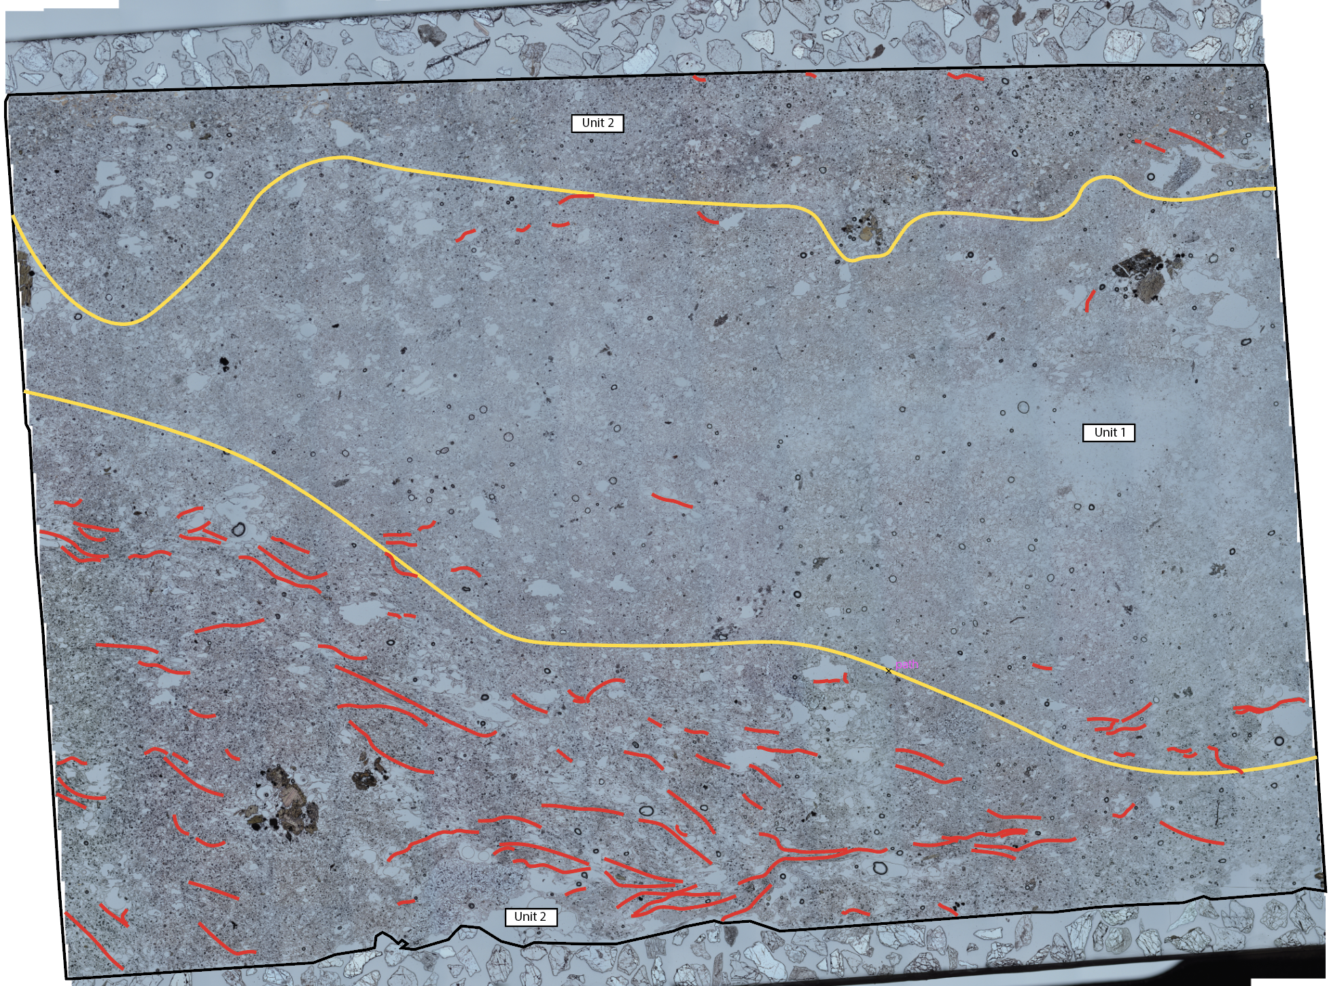
Thin Section Mapping
A.
B.
Legend:
Figure 3: Examples of thin section mapping. A. High density sample from the Upper I Unit showing heavy shearing. B. Low density sample from the Lower I Unit showing minimal shearing. Both show contacts between two different textures.
Shear
Unit contacts
Boundary

Slide 8
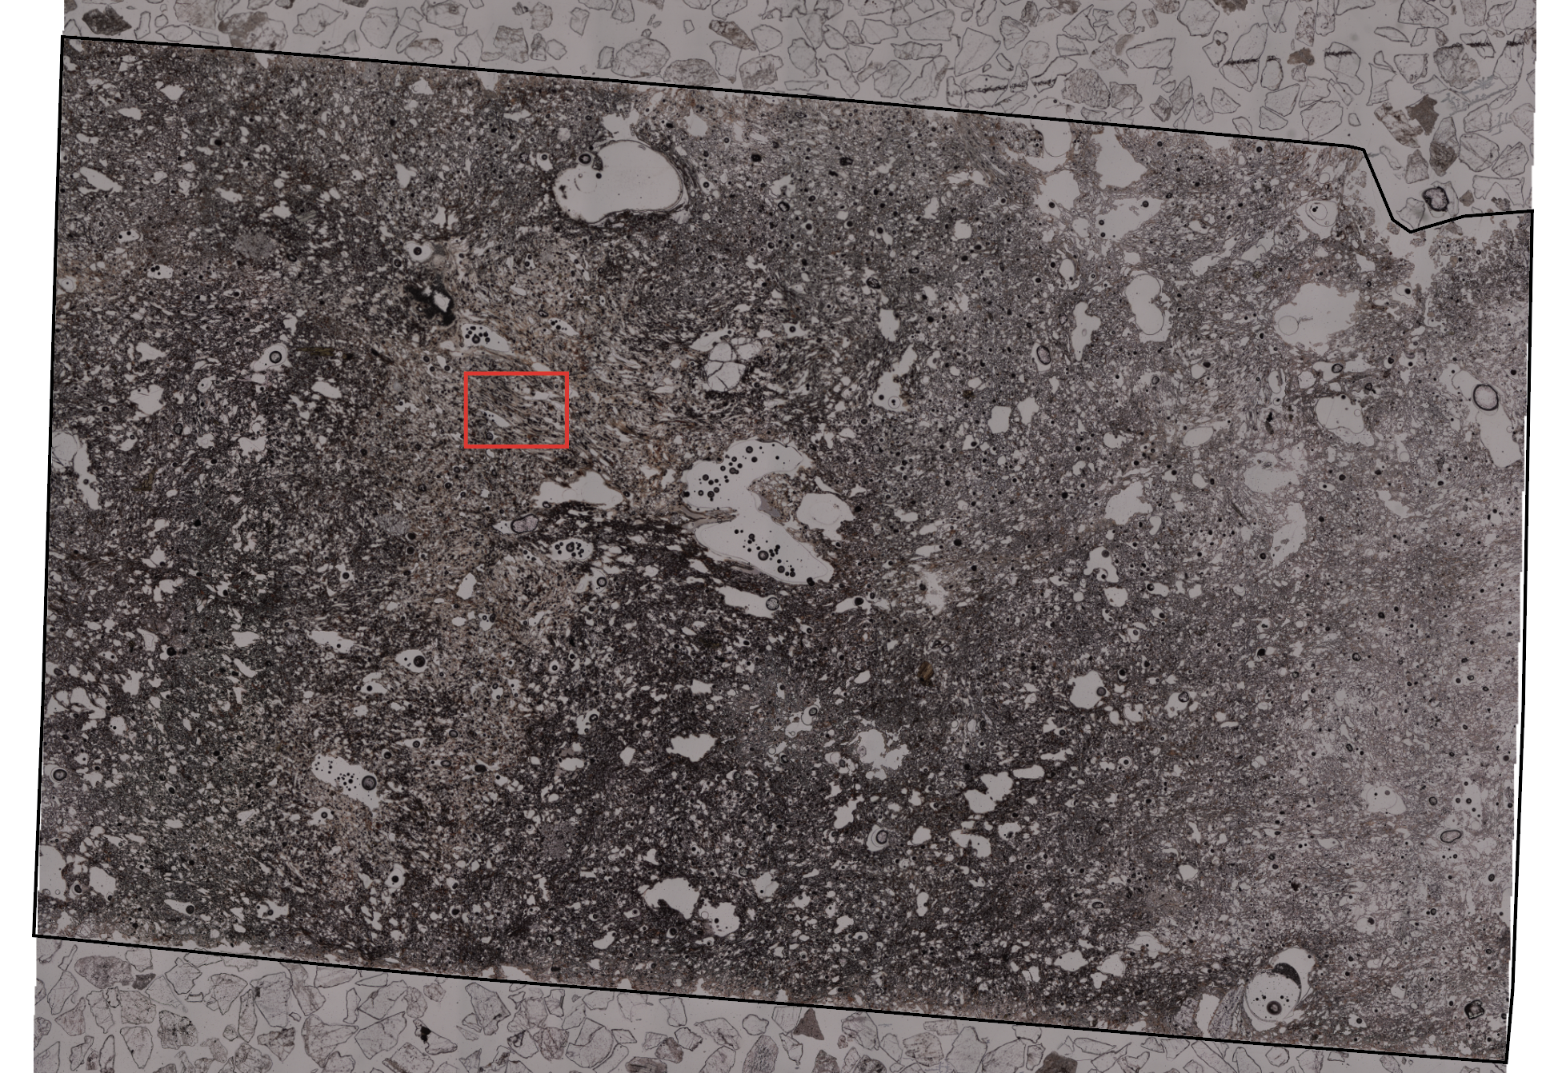
Backscattered Electron Images (BSE)
BSE images were taken using the Scanning Electron Microscope to look at bubble morphology.
High magnification shows there are no fine crystals (microlites) in the groundmass. The ground mass is all glass meaning the ascent rate was rapid.

Slide 9
Conclusions
The densities represent how vesiculated the magma was during the eruption. Both upper and lower are very vesiculated representing very high gas content.
Dual peak in density distribution might represent conduit edge vs core.
Different textures in the thin section could be due to conditions during magma ascent or magma mixing.
  Bubble shapes indicate very high shear.
  Lack of microlites indicate rapid ascent and quench.
Injection of new hot magma (mafic composition) could have rejuvenated the magma chamber causing the most recent eruption and may have left the chamber in ‘an eruptible state’ for future eruptions.

Slide 10
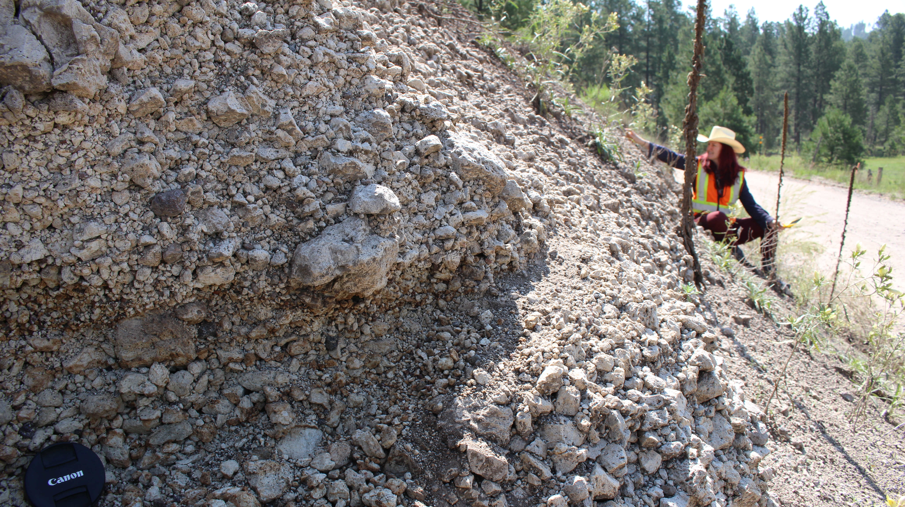
Future Work
Document the shape and distributions of bubbles to quantify ascent velocity and shear of magma.

Slide 11
Thank you
Any questions?
References & Acknowledgements
1.Boro, Wolff, J. A., & Neill, O. K. (2020). Anatomy of a Recharge Magma: Hornblende Dacite Pumice from the rhyolitic Tshirege Member of the Bandelier Tuff, Valles Caldera, NM, USA. Contr. to Min and Pet, 175(10). 2. Goff, F., Gardner, J.N., Reneau, S.L., Kelley, S.A., Kempter, K.A., Lawrence, J.R., (2011). Geologic map of the Valles caldera, Jemez Mountains, New Mexico: New Mexico Bureau of Geology and Mineral Resources, Geologic Map 79, 1:50,000 scale. 3. Houghton, B.F., Wilson, C.J.N., 1989. A vesicularity index for pyroclastic deposits. Bull. Volcanol. 51, 451-462. 4. Self, S., Kircher, D.E., Wolff, J.A., (1988). The El Cajete Series, Valles caldera, NM. Journ. of Geophys. Research 93, 6113–6127. 5. Wolff, Brunstad, K. ., & Gardner, J. (2011). Reconstruction of the most recent volcanic eruptions from the Valles caldera, NM. Journ. of Volcanol. and Geotherm. Research, 199(1-2), 53–68. 6. Wolff, J., & Gardner, J. (1995). Is the Valles Caldera entering a new cycle of activity? Geology (Boulder), 23(5), 411–414. Geology (Boulder), 23(5), 411–414.
I would like to thank the ASU/NASA Space Grant as well as Amanda Clarke, Jacqueline Giblin, Jisoo kim, and Kurt Roggensack for their support along the way.

